Slide 1
Key information & vaccination reminders
February 2026

Slide 2
contents:
Transmission
Clinical signs & dummy calves
Vaccination
Fertility myth-busting
Resources reminder
summary

Slide 3
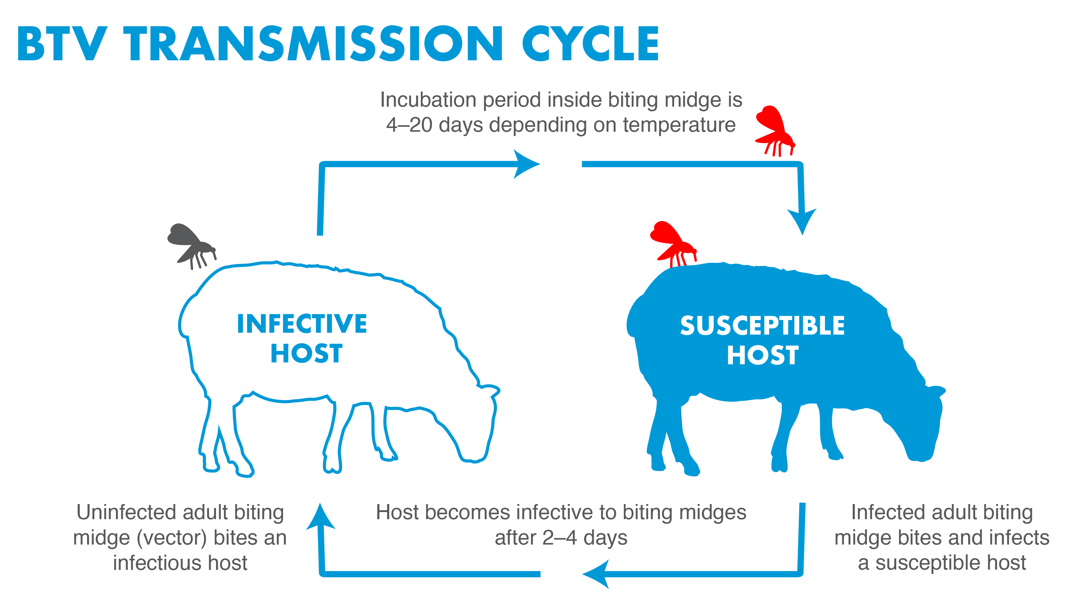
Transmission:
Biting midges (Culicoides species) are the most common source of infection between susceptible livestock
It can also spread through movement and import of animals
Or through semen, ova, embryos or foetuses
The time of year, weather conditions and animal density can all affect transmission
Once a biting midge is infected with bluetongue virus, it can transmit the virus for the rest of its life. Adults typically live for up to a month, but can survive longer
Notes:
More information on transmission can be found at: https://www.gov.uk/guidance/bluetongue-how-to-prevent-it-and-stop-it-spreading
Highest risk of spreading between the months of April and November – when temperatures are warmer

Slide 4
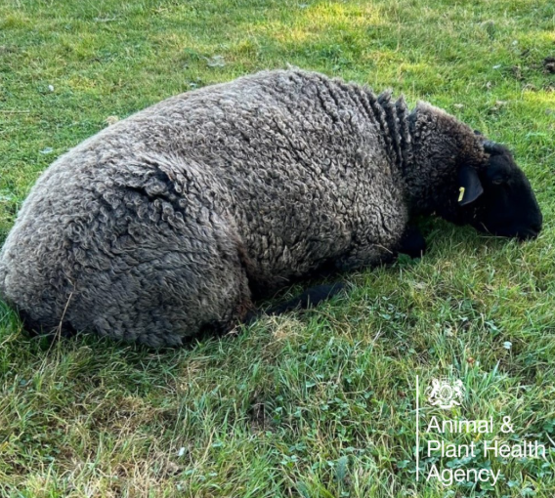
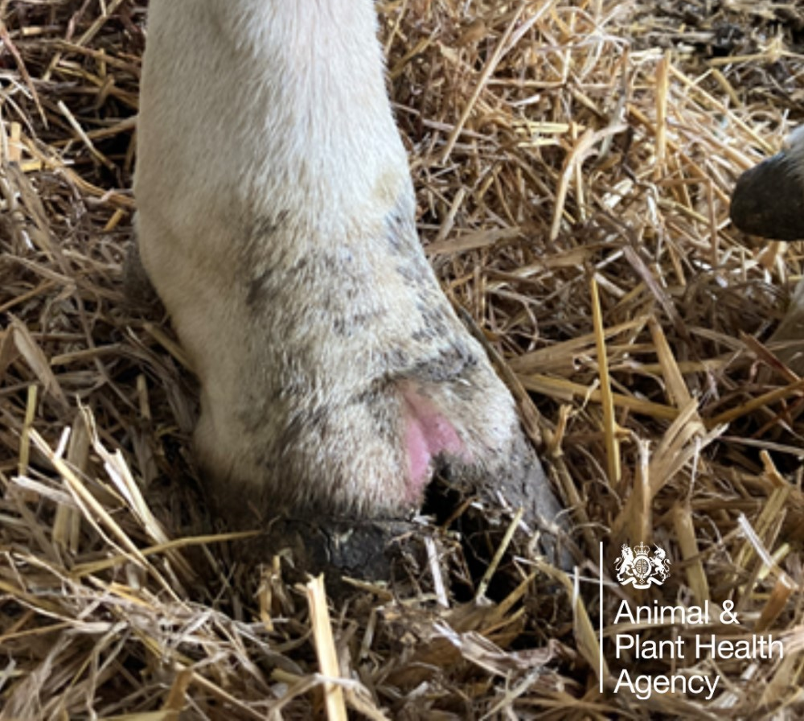
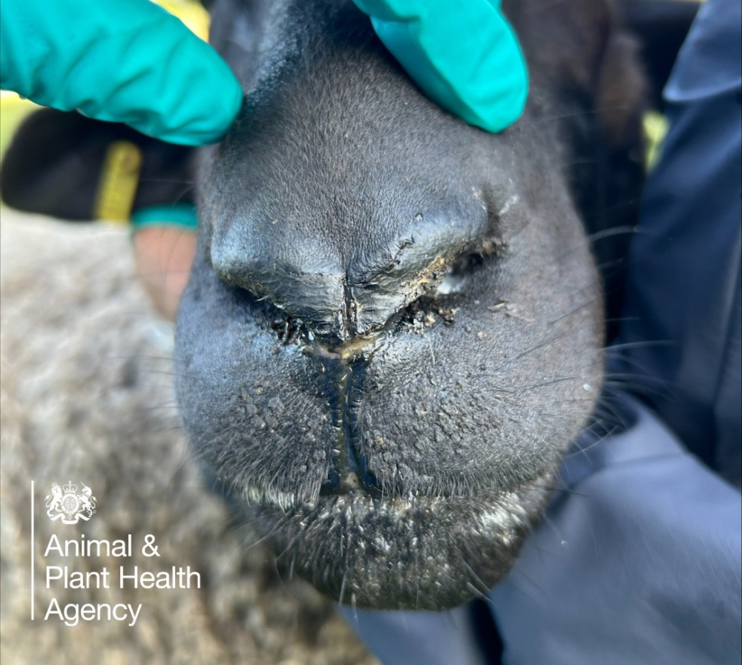
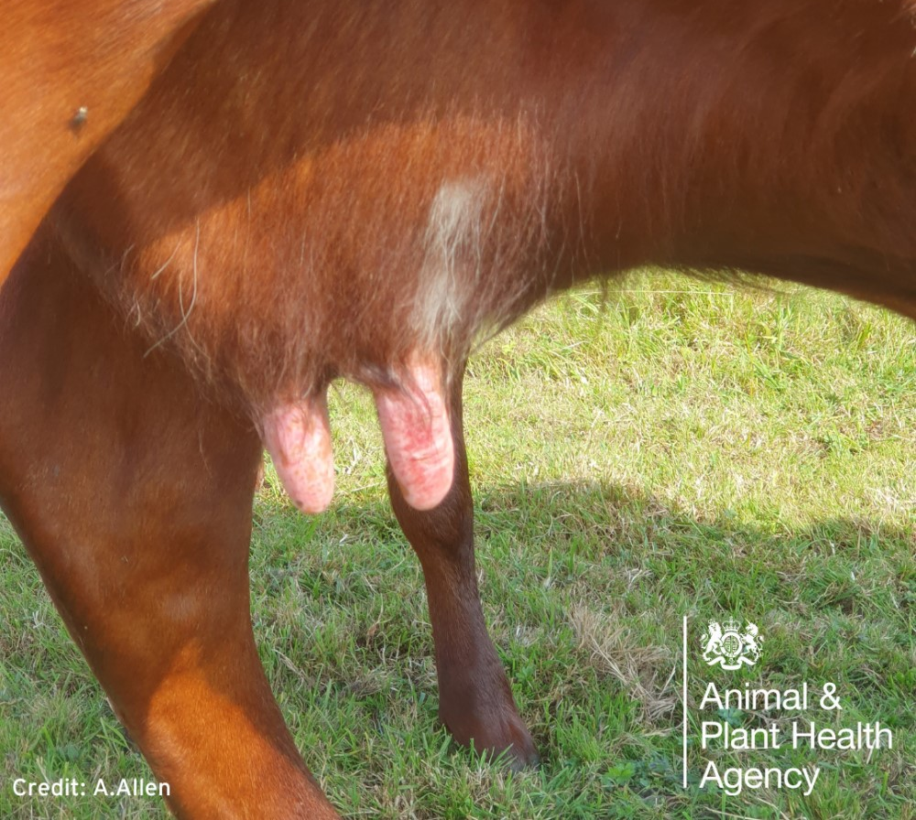
Signs of Bluetongue in:
  Adult Cattle:
Reddening and erosions on the teats
Crusty erosions around the nostrils and muzzle
Nasal discharge
Redness of the mouth,
eyes, nose
Cattle do not often
show clear signs of disease so also look
out for signs of lethargy and lower productivity including reduced
milk yield
  Sheep:
Ulcers or sores in the mouth and nose
Discharge from the eyes or nose and drooling from mouth
Swelling of the lips, tongue, head and neck and the coronary band
Fever
Lameness
Abortion (high barren rates), foetal deformities and stillbirths
Death
  Calves:
Born small, weak, deformed or blind (‘dummy’ calves)
Death of calves within
a few days of birth
Stillbirths
Abortions
Notes:
More images from APHA are available on the AHDB website: https://ahdb.org.uk/clinical-signs-of-bluetongue
Remember that Bluetongue is a notifiable disease. If you suspect it, you must report it immediately by calling the Defra Rural Services Helpline on 03000 200 301. In Wales, contact 0300 303 8268. In Scotland, contact your local Field Services Office. Failure to do so is an offence.

Slide 5
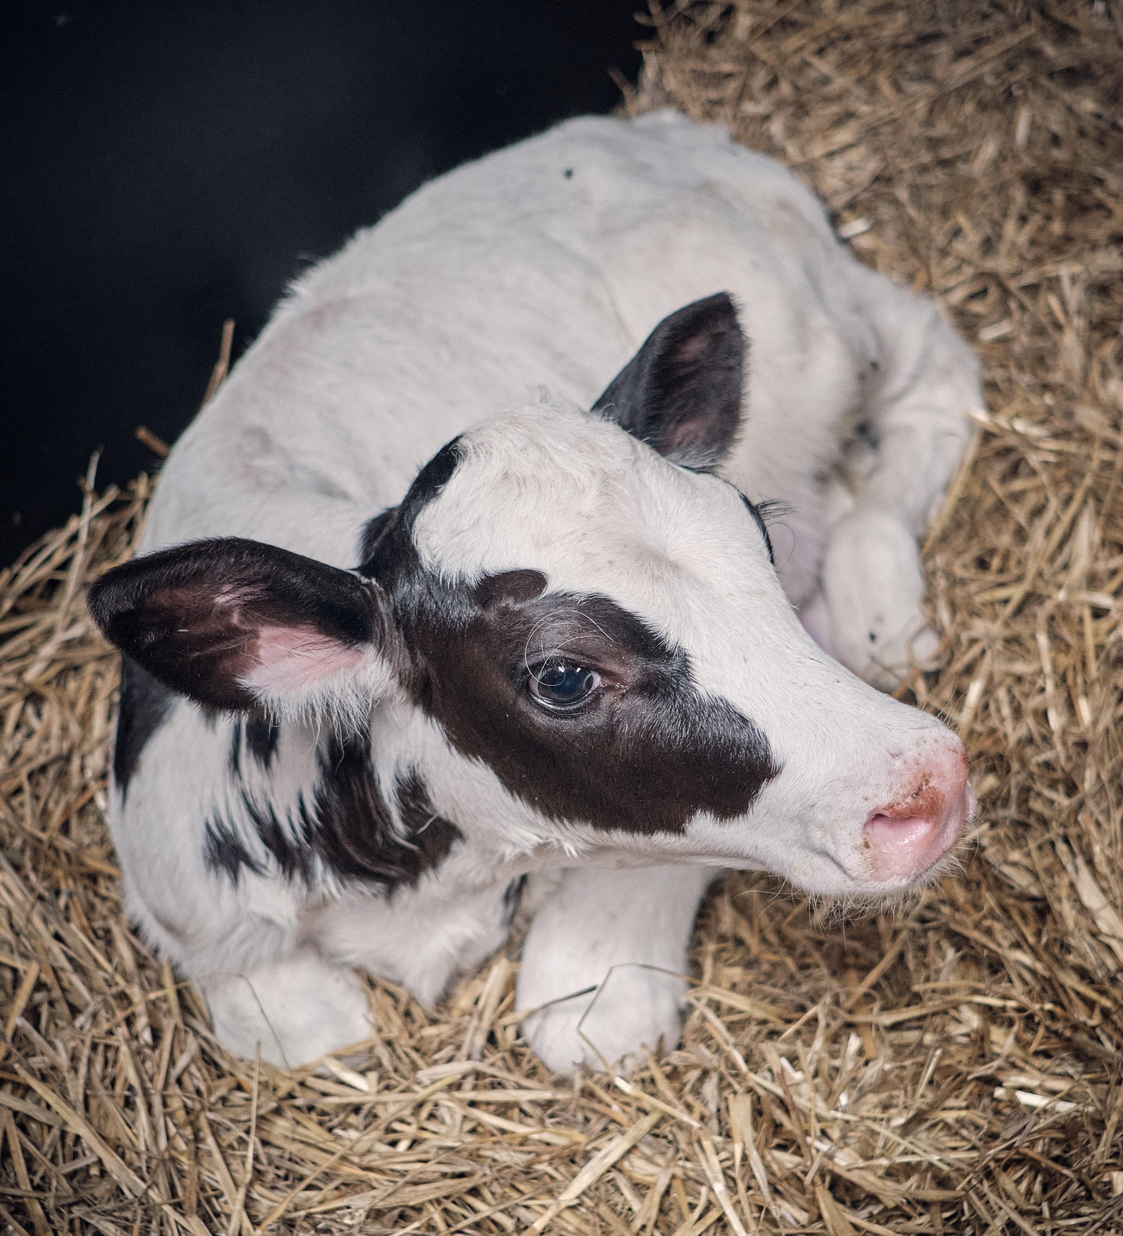
‘Dummy’ Calves
Fertility issues or ‘dummy’ calves may be the first obvious signs of BTV infection in your herd
Signs to look out for in calves:
Head pressing
Weakness
Blindness
Stargazing
Wide based gait
Seizures
Passive demeanour
Difficulty standing
Circling
Lack of suck reflex
Impact of BTV-3 on Calves Webinar:
The impact of BTV-3 on calves and reproductive performance - April 2025 | AHDB Webinar
Notes:
Some of the clinical signs seen in 2025 with dummy calves

Slide 6
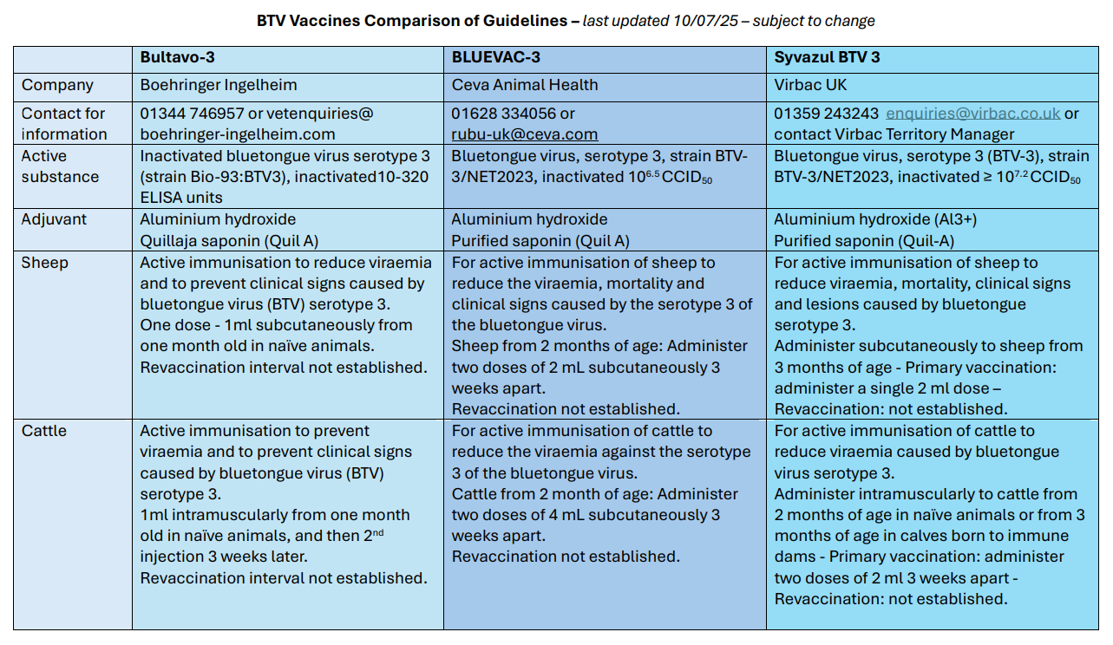
Vaccination:
There are 3 BTV-3 vaccines permitted for use in GB subject to valid licence and declaration
There is no treatment for this disease, vaccination and restricted movement in affected areas remains the best defence
Farmers are encouraged to speak to their
vet and develop farm specific battle plans
See the Vaccine Comparison Tables on the RH&W website for more information on the individual vaccines Updated-BTV-Vaccines-comparison-table-10.07.25.pdf
BTV-8 vaccines in Europe, resources will be available on the RH&W/ AHDB websites
BCVA/ SVS Vaccination Guidance:
https://ruminanthw.org.uk/wp-content/uploads/2026/02/Bluetongue-Vaccination-Fertility-–-an-overview-for-vets-2026.pdf
Notes:
Recent BCVA/SVS vaccination guidance: https://ruminanthw.org.uk/wp-content/uploads/2026/02/Bluetongue-Vaccination-Fertility-–-an-overview-for-vets-2026.pdf
For more information on the vaccines: https://www.gov.uk/guidance/bluetongue-serotype-3-btv-3-vaccination

Slide 7
DOES BTV-3 VACCINATION AFFECT FERTILITY IN SHEEP OR CATTLE?
There is no evidence to suggest the BTV-3 vaccines will have a negative impact on fertility either within males or pregnant females.
The disease itself, however, can cause abortions, foetal deformities and stillbirths. Speak to your vet for advice on when to vaccinate your animals.
Notes:
This is taken from one of our myth busting graphics – you can find the rest at: https://ruminanthw.org.uk/bluetongue-virus-hub/bluetongue-virus-information-for-vets/battlebluetongue-vet-information/

Slide 8
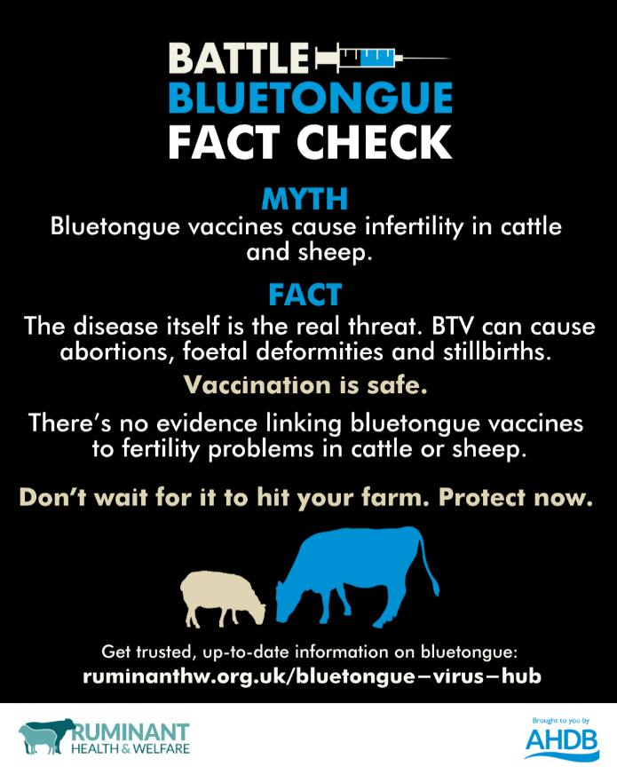
Reproductive issues caused by Bluetongue infection
In cows/calves:
Poor scanning rates
Abortions
Stillbirths
Weak born calves
‘Dummy’ calves
In bulls:
Bluetongue virus can be retained in the testes and infect cows during mating
Infection of the bull may have a more severe effect on herd fertility
In the most severely affected herds in 2025, the combined fertility effects resulted in only 50% of the herd producing viable calves
Notes:
It is important to note that Bluetongue virus can have a severe impact on fertility.
In contrast, there is no evidence to suggest that the BTV vaccines will have a negative impact on fertility. Millions of doses have been sold across Europe and data has been collected with no evidence to suggest ill effect on fertility from BTV-3 vaccination.

Slide 9
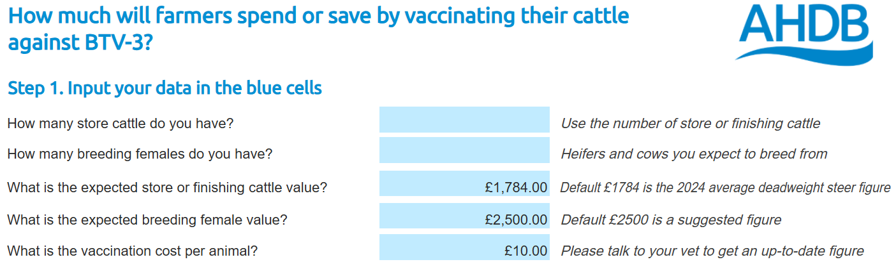
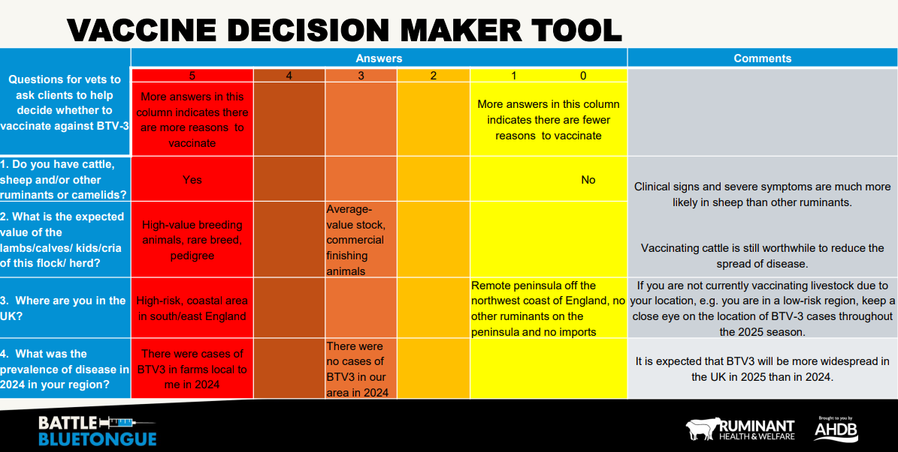

BATTLE BLUETONGUE Campaign materials
available
Vaccine Decision Maker Tool
Vaccination Finance Calculators
Bluetongue Movements Checker
Vaccination Comparison Tables
‘Is it too late to vaccinate’ tool
Myth busting graphics
Posters
PowerPoint template
Farmer leaflet
FAQs
Social media graphics
and posts
All available via Ruminant Health
& Welfare Bluetongue Hub and AHDB website
Notes:
Links to resources:
Bluetongue Movements Checker – allows you to find the correct advice and licensing requirements for moving animals within or across a border within GB: https://ruminanthw.org.uk/bluetongue-virus-hub/bluetongue-movements-checker/
BTV-3 Vaccination Finance Calculators – allow you to calculate how much it will cost you to vaccinate your stock against BTV-3 and compare this with how much vaccinating could save you if you were to have bluetongue on your farm:
Beef – https://ahdb.org.uk/knowledge-library/btv-3-vaccination-finance-calculator-beef
Sheep – https://ahdb.org.uk/knowledge-library/btv-3-vaccination-finance-calculator-sheep
Dairy - https://ahdb.org.uk/knowledge-library/btv-3-vaccination-finance-calculator-dairy
Vaccine Decision Maker Tool – developed to start conversations between farmers and their vets about the farms risk to BTV-3 and whether vaccination is right for your farm: https://ruminanthw.org.uk/wp-content/uploads/2025/02/BattleBluetongue-vaccine-decision-maker-tool-February-2025-.pdf
Vaccine Comparison Tables – allow you to compare the properties of the three BTV-3 vaccines and their claims: https://ruminanthw.org.uk/wp-content/uploads/2025/07/Updated-BTV-Vaccines-comparison-table-10.07.25.pdf
Bluetongue Myth Busting Series – a series of graphics designed to stamp out rumours circulating about bluetongue and the vaccines available: https://ruminanthw.org.uk/bluetongue-virus-hub/bluetongue-virus-information-for-vets/battlebluetongue-vet-information/

Slide 10
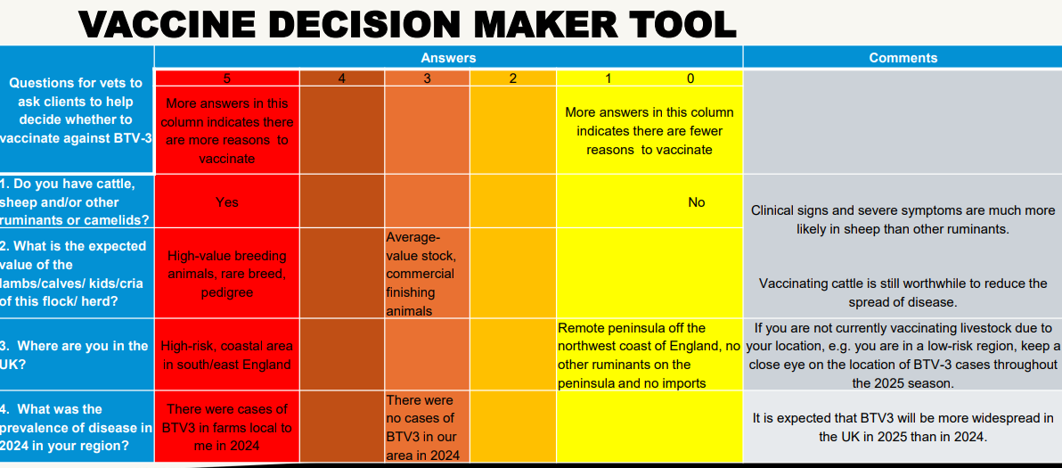
Available via Ruminant Health
& Welfare Bluetongue Hub and AHDB website
Notes:
Vaccine Decision Maker Tool – developed to start conversations between farmers and their vets about the farms risk to BTV-3 and whether vaccination is right for your farm: https://ruminanthw.org.uk/wp-content/uploads/2025/02/BattleBluetongue-vaccine-decision-maker-tool-February-2025-.pdf

Slide 11
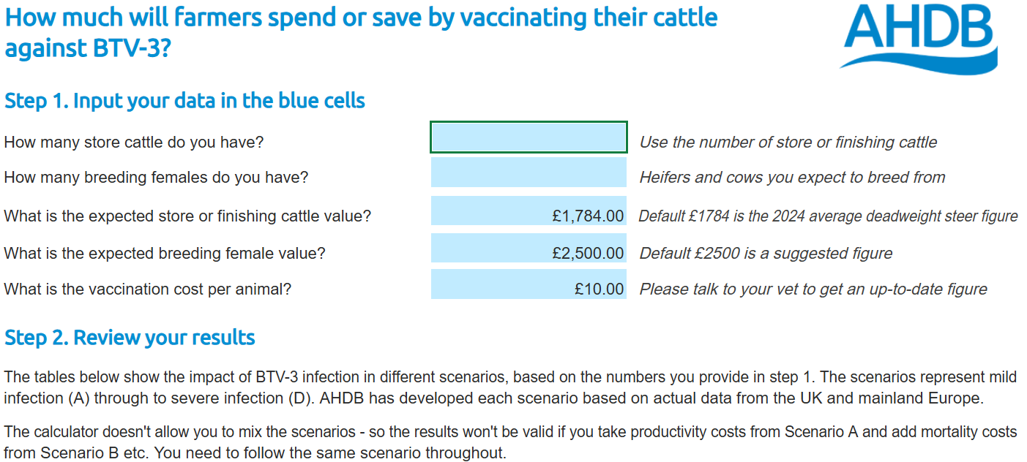
Vaccine Finance calculators
Calculators for Sheep, Dairy and Beef available on the AHDB website
Notes:
BTV-3 Vaccination Finance Calculators – allow you to calculate how much it will cost you to vaccinate your stock against BTV-3 by inputting farm figures and compare this with how much vaccinating could save you if you were to have bluetongue on your farm:
Beef – https://ahdb.org.uk/knowledge-library/btv-3-vaccination-finance-calculator-beef
Sheep – https://ahdb.org.uk/knowledge-library/btv-3-vaccination-finance-calculator-sheep
Dairy - https://ahdb.org.uk/knowledge-library/btv-3-vaccination-finance-calculator-dairy

Slide 12
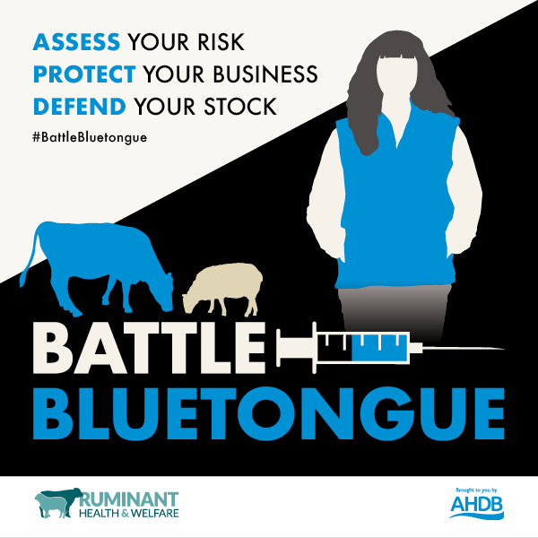
Summary:
Bluetongue affects ruminants (such as cattle, sheep, goats, and deer) and camelids (such as llamas and alpacas)
Mainly spread by biting midges
Three BTV-3 vaccines available
Vaccines do not affect fertility
Resources on clinical signs &
vaccine decision making tools
available on the Ruminant
Health & Welfare and AHDB
websites
Bluetongue is a notifiable disease.
If you suspect it, you must report it immediately by calling:
03000 200 301 in England
03003 038 268 in Wales
Your local Field Services Office in Scotland

Slide 13
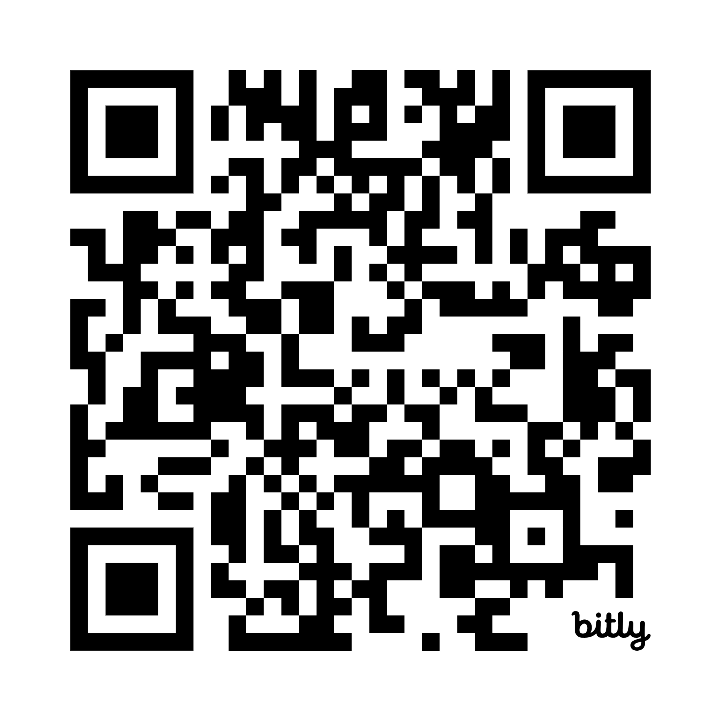
Scan this QR code for the Battle Bluetongue hub page:
Notes:
QR linking to the Battle Bluetongue hub with further tools and resources

