Slide 1
Myth Busting – 18.08.26

Slide 2
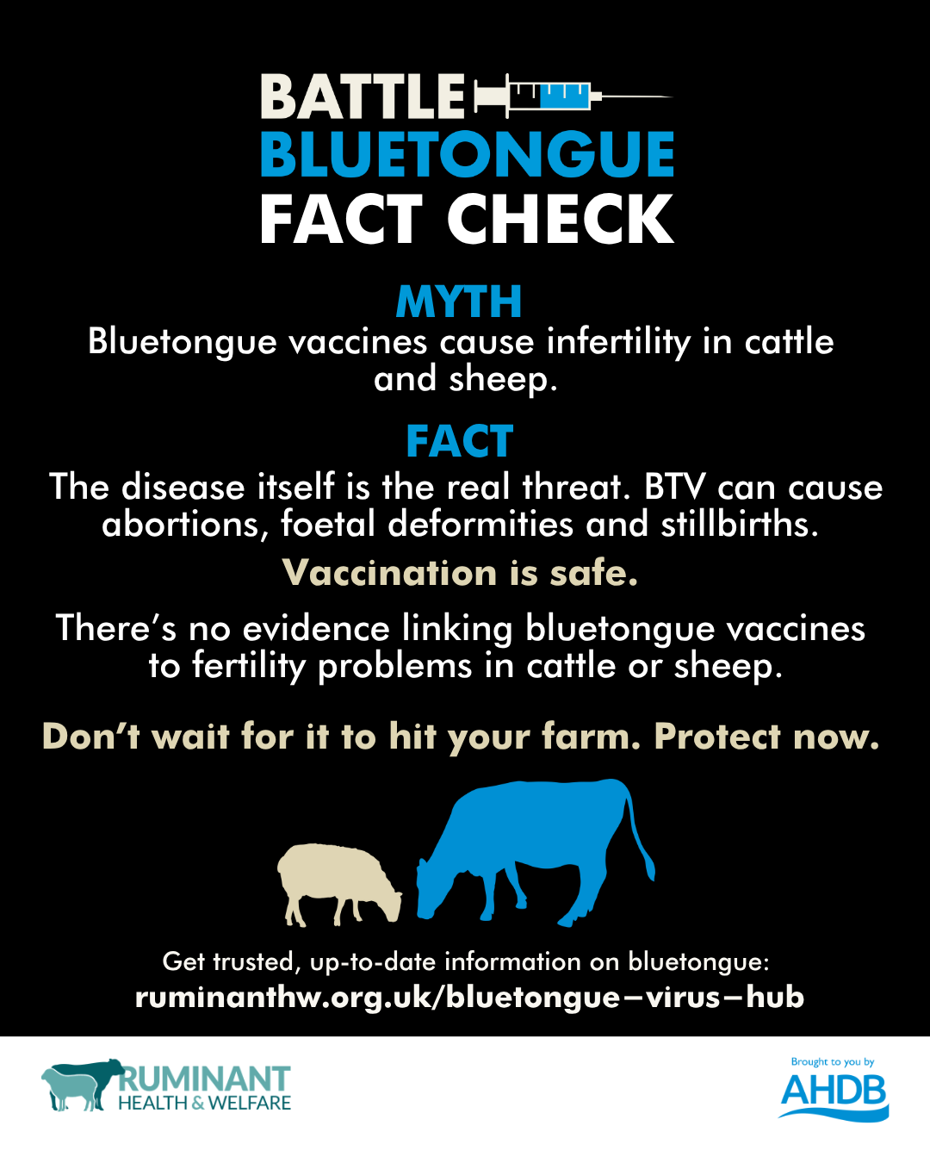

Slide 3
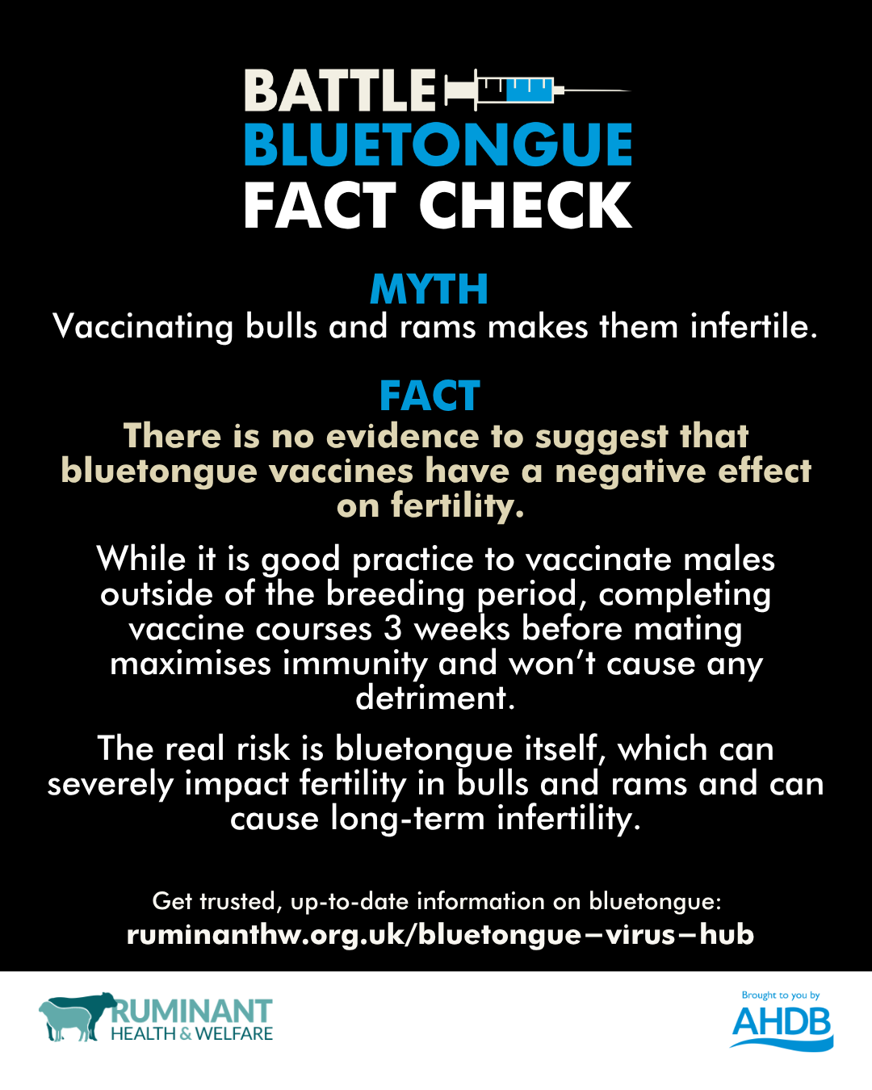

Slide 4
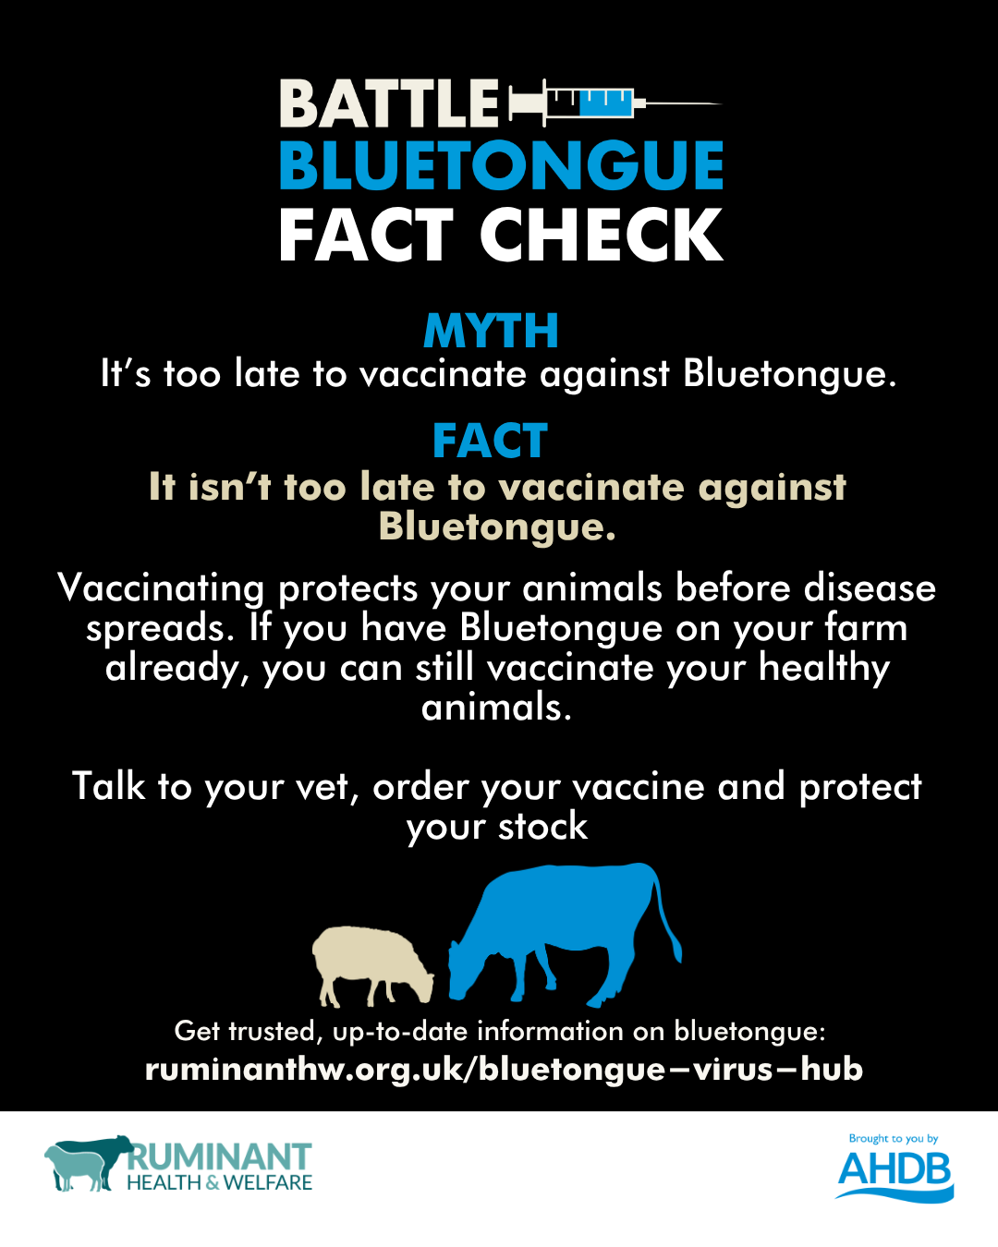

Slide 5
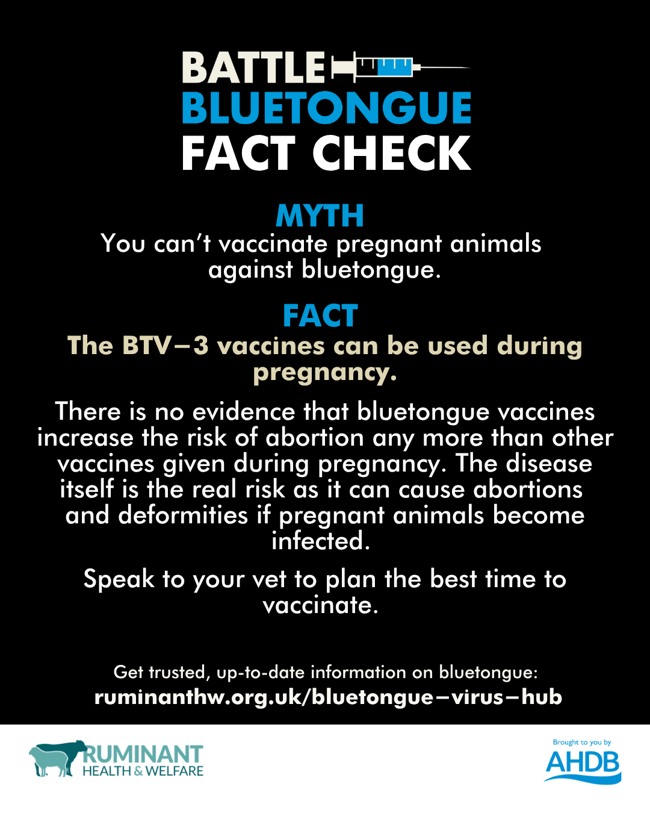

Slide 6
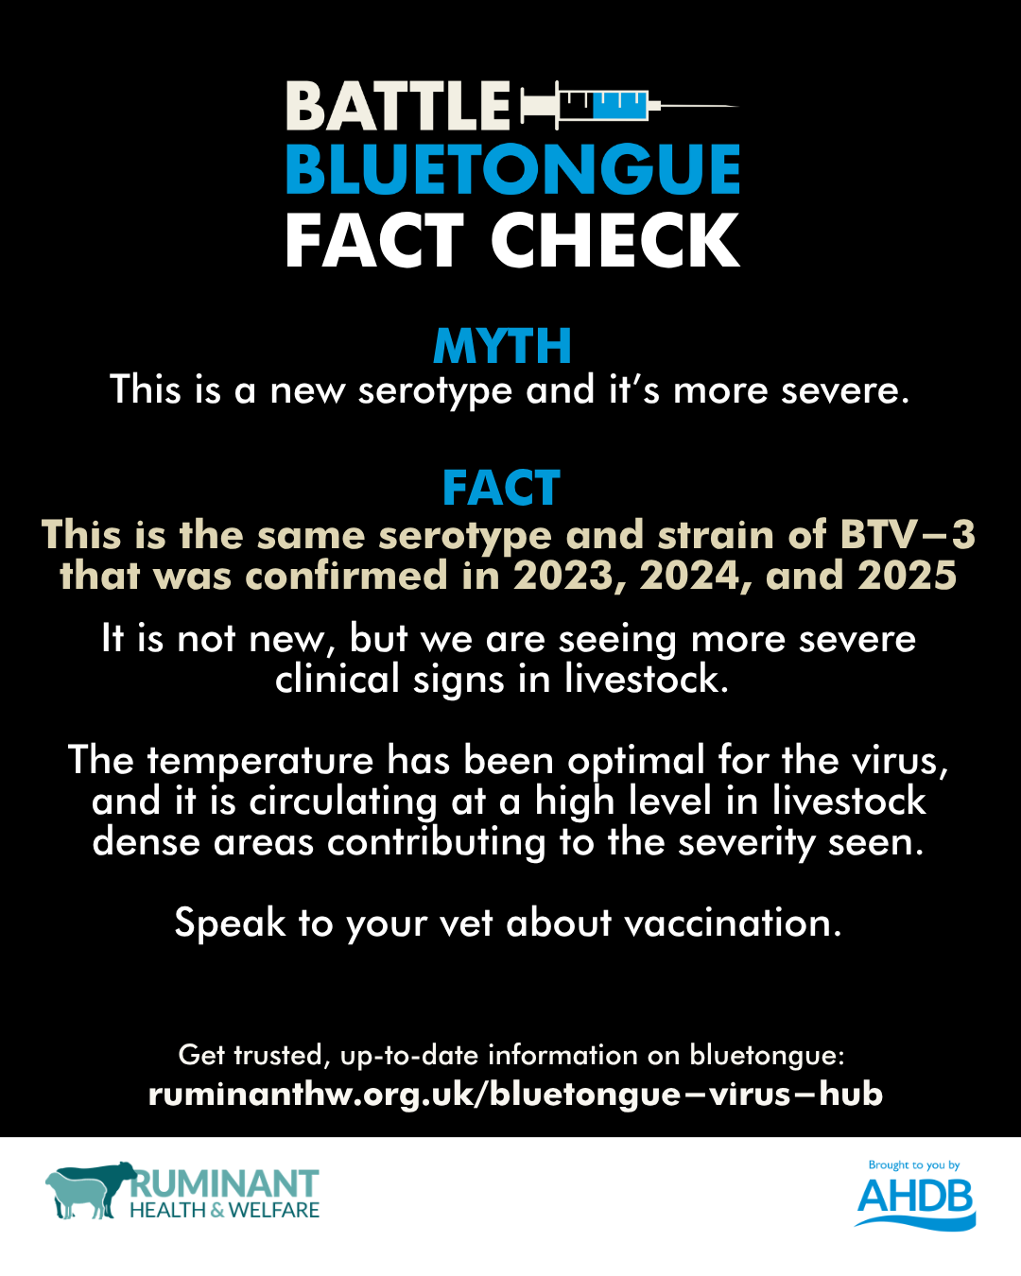

Slide 7
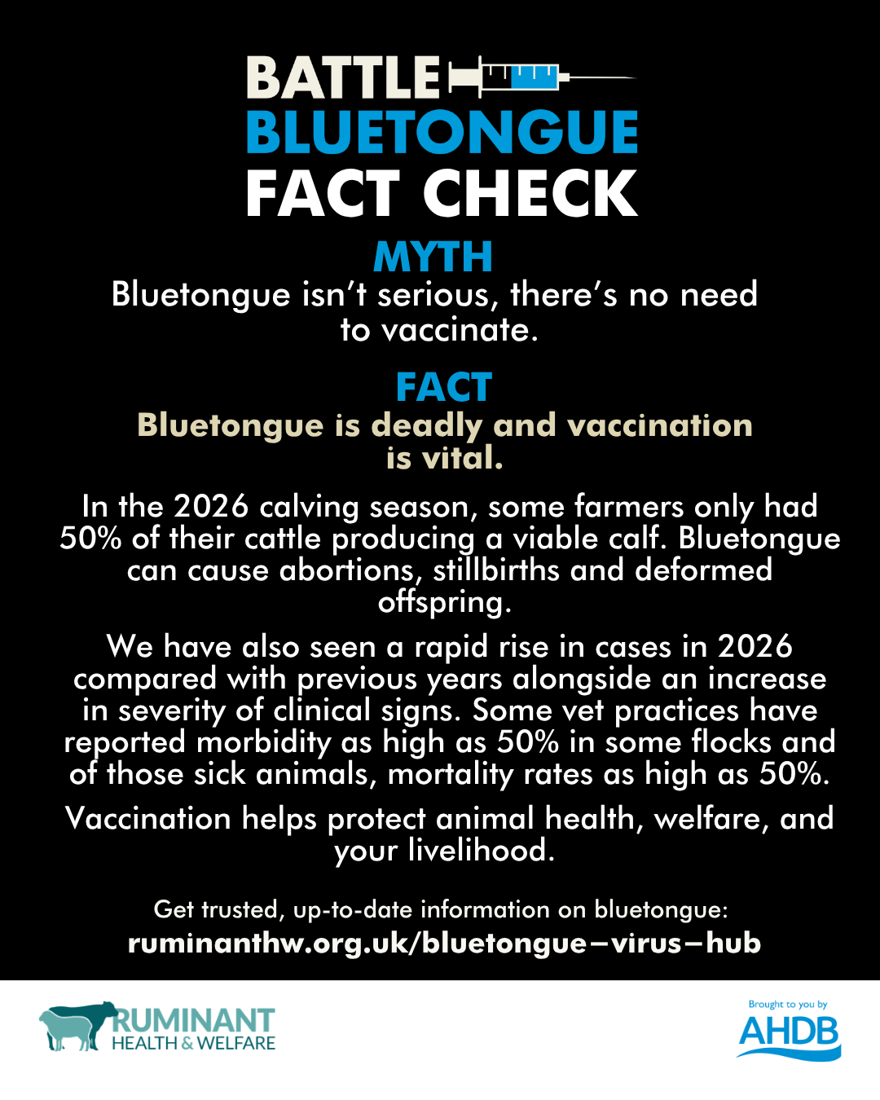

Slide 8
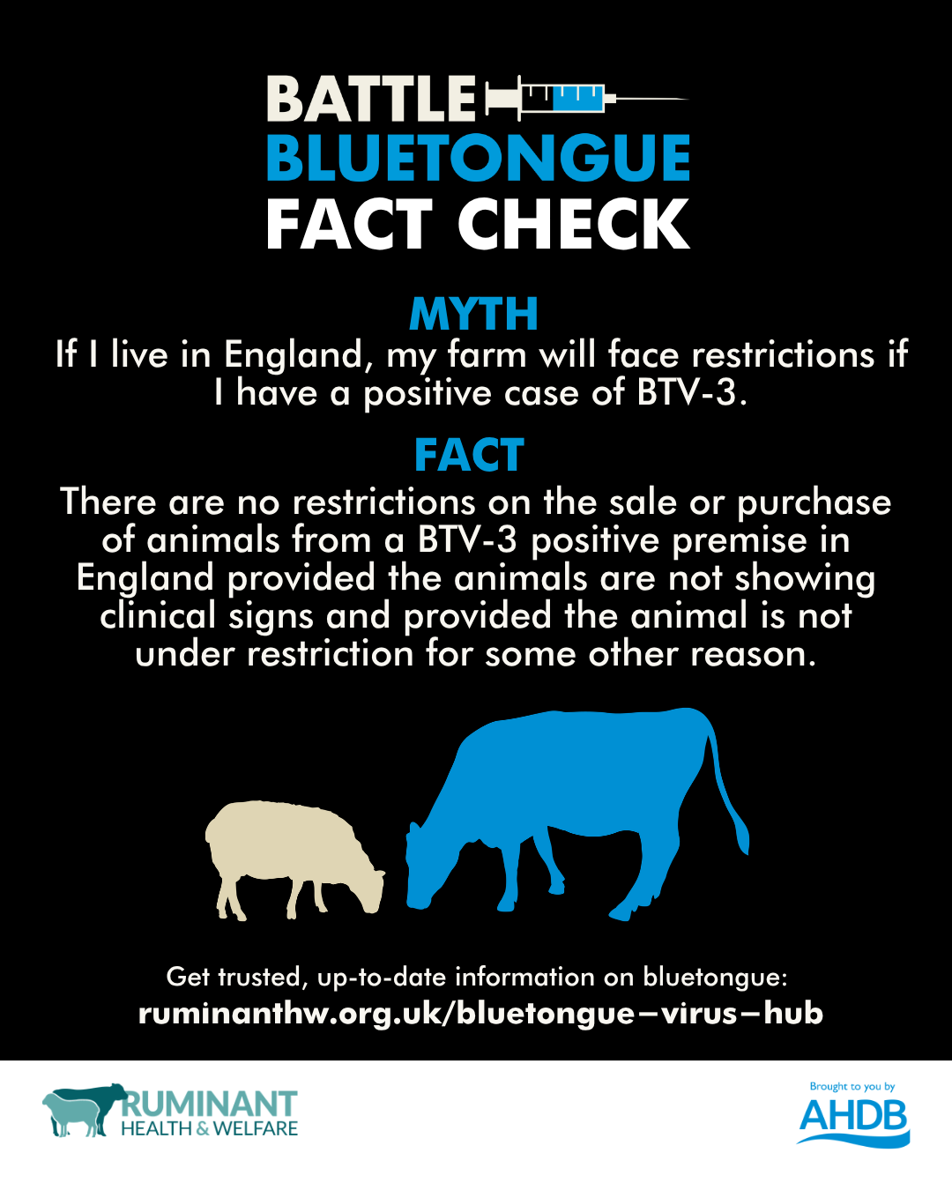
See the GOV.UK website for more information: https://www.gov.uk/guidance/bluetongue-latest-situation

Slide 9

See the APHA map for more information: https://experience.arcgis.com/experience/4867f4e1f680415898482df7aabb703d/page/Page

Slide 10
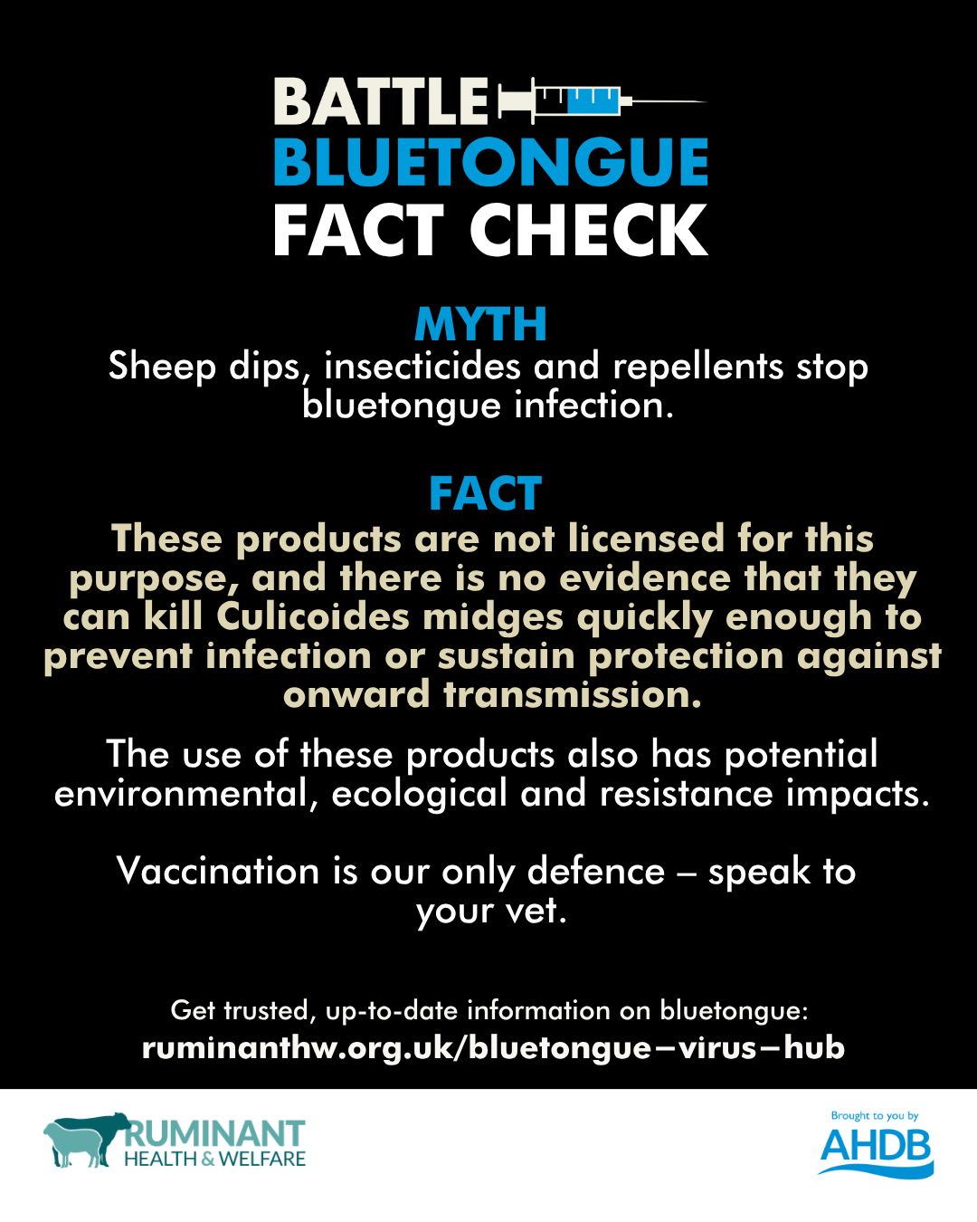
See the SCOPS website for more information: https://www.scops.org.uk/news/43907/bluetongue-virus-btv-clear-advice-on-insecticides-op-dips-and-midge-control/

Slide 11
